Slide 1




Review of Core Topic
ISO/IEC 5230, ISO/IEC 18974 and ISO/IEC 5962
How updates to international standards for open source license compliance, security assurance and SBOM impact the automotive supply chain

Slide 2

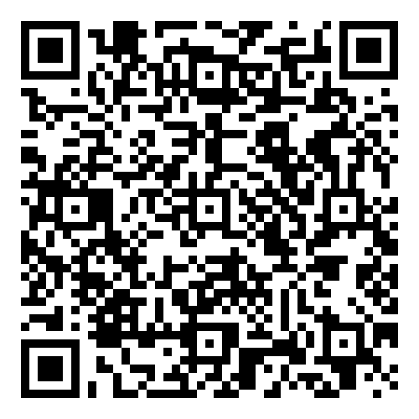
Starting 2024-06-19 ~ Ending 2024-012-19
The OpenChain Project has announced the beginning of its six month Public Comment Period for proposed draft updates to the open source license compliance (ISO/IEC 5230:2020) and open source security assurance (ISO/IEC 18974:2023) specifications.
As per our specification development process outlined in the project FAQ, this Public Comment Period will run for six months, and it will be followed by a three month Freeze Period.

Slide 3
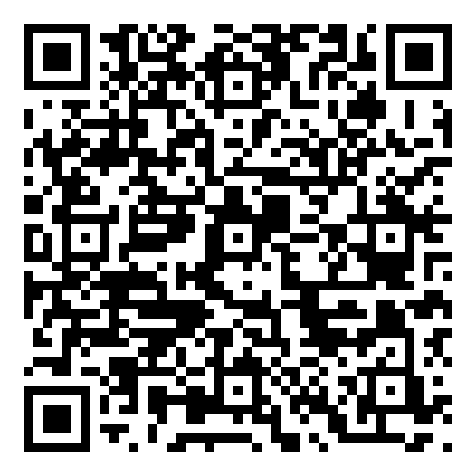
Draft Update ISO Standards – The Open Issues
The public comment for proposed updates to ISO 5230 and ISO 18974 continues. On this call, we will check out some of the comments about typos, language clarity and so on. There are various pull requests (submissions) on GitHub.
ISO/IEC 5230 (License Compliance)
ISO/IEC 18974 (Security Assurance)

Slide 4

The Impact on the Automotive Supply Chain

Slide 5
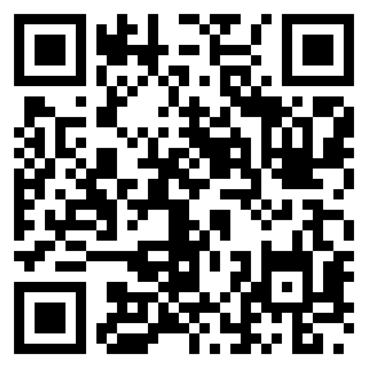
Track All This Work
Our calls are open and publicly listed.
We publish a recording of every meeting not under Chatham House Rule.
We provide access to work groups, special interest groups and local work groups via mailing list.
We also use Slack and WeChat.
All the details can be found on our participation page.

